Slide 1
Customer Programs Enrollment Center
-Solution Framework

Slide 2
Agenda
Customer Programs Enrollment Center (EC) Framework
Standalone Enrollment Center for the existing customers.
EC Integration with Contract Management ( Move-in Process, Change Contracts)

Slide 3
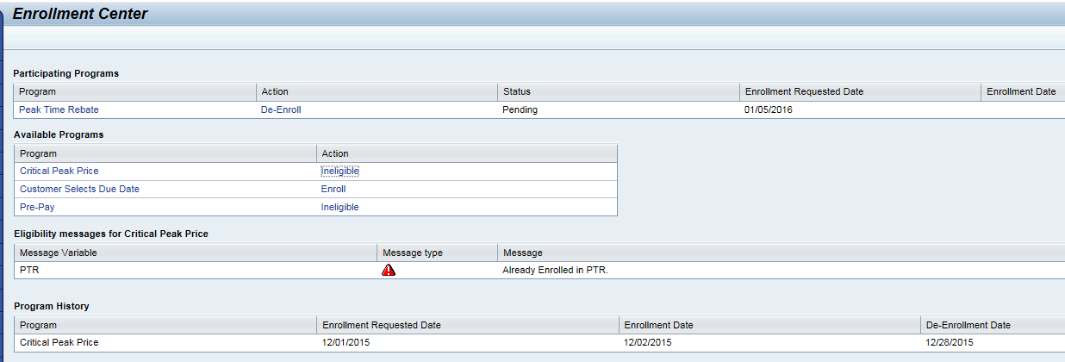
Enrollment Center screen has four main component
Participating Program
Available Program
Eligibility Messages
Program History

Slide 4
Enrollment Center Components
Participating Program:-
All enrolled programs listed, with a one-click button to de- enroll, following de-enrollment step or prompts.
“Program Status” Not a CSR drop-down, Just demonstrates possible statuses ex:- Enrollment Request , Enrollment Pending, Enrollment rejected.
Enrollment request date and Actual Program enroll date
Available Program
Hyperlinks provide one-click access the program information.
Hyperlinks provide one-click access to enroll, following enrollment step.
Eligibility Messages
More customer- specific eligibility details (ex:-de- enrollment from another program).
Program History
Enrollment History can be maintained, to build process/ system eligibility rules.

Slide 5
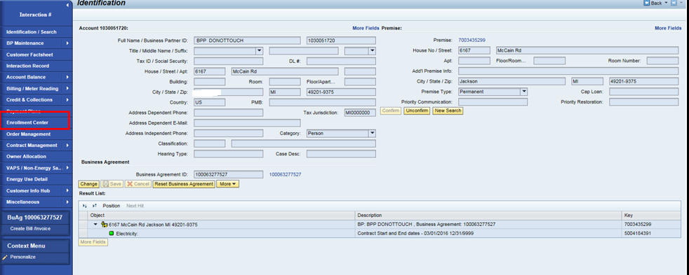
Standalone Enrollment Center
All Customer Programs Enrolled via Enrollment work center for active customers

Slide 6
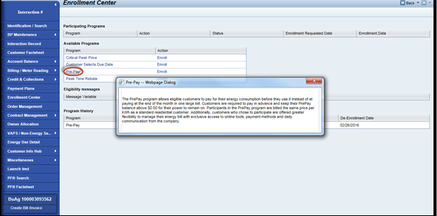
Enrollment Center

Slide 7
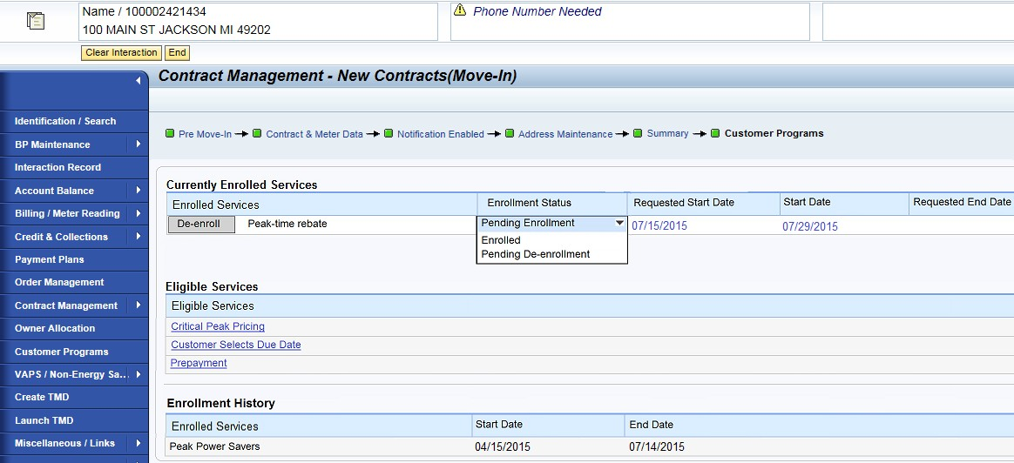

CM integration (New Contract only)
New step in the Guided process during New Contracts (Move-In) only.

Slide 8
Enrollment Center

Slide 9
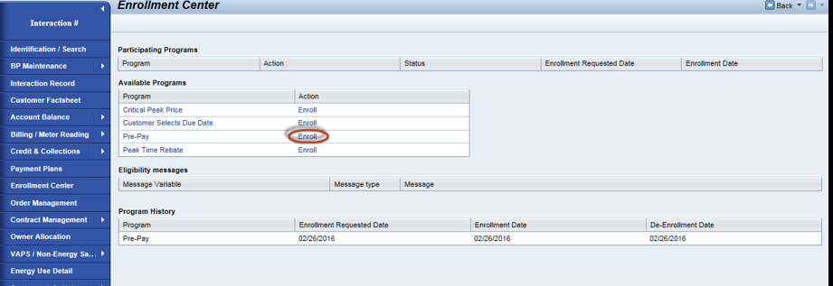
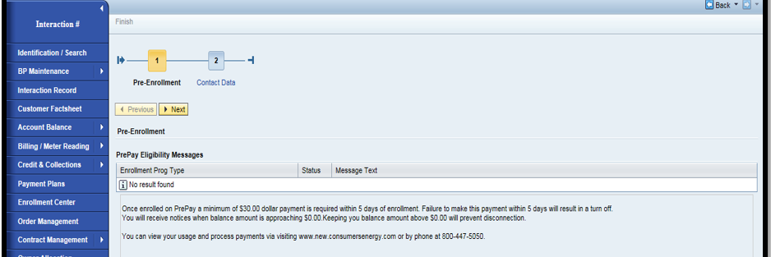
Program Enrollment

Slide 10
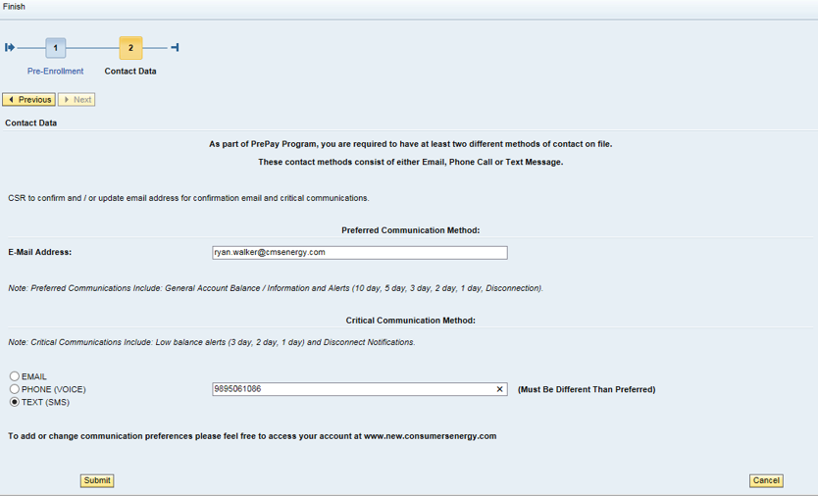
Program Enrollment…

Slide 11
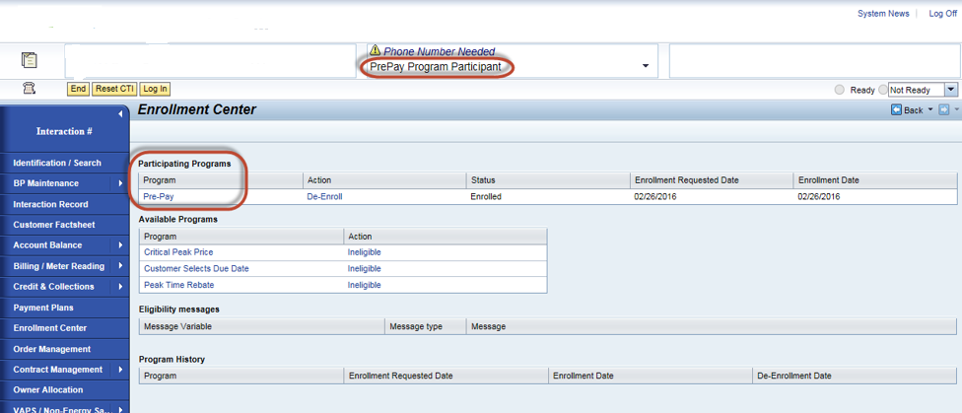

Slide 12
Enrollment Center Framework
Before displaying the enrollment center, Eligibility check is performed on the programs to check whether the programs are eligible or not
By implementing this solution the CSRs will require minimal effort in enrolling/de-enrolling a customer into Energy efficiency programs
CSR will also achieve greater visibility into the customer’s program participation.

Slide 13
THANK YOU

